Slide 1

June 6 Videoconference Call
Arnie Schneider
Brett Tambling
Scheller College of Business

Slide 2
MGT8803 Business Fundamentals for Analytics Video Conference Call #5 Course Update
Homework Assignment #2 (Managerial Accounting) is Due on Wednesday, June 12 by 11:59pm eastern daylight time
This call will conclude the videoconferences related to the Accounting Modules
Our call next Thursday will be the first call devoted to the Financial Analytical Techniques module. Answers to the Managerial Accounting Homework will be Posted in a Separate Video prior to the 7:00 pm videoconference. We will take Homework related Questions During the Video Conference Call
This week focus on completing the Managerial Accounting Module and Homework Assignment #2. Try to complete Topic 1 in Financial Analytical Techniques By Thursday’s call.

Slide 3
MGT8803 Business Fundamentals for Analytics Video Conference Call #5 Managerial Accounting
Material and Labor Cost Variances
Accounting Data and Decision-Making

Slide 4
MGT8803 Business Fundamentals for Analytics
Video Conference Call #5 Managerial Accounting Questions from the Forum
Are there any accounting standards in the U.S. that deal specifically with costing/valuation of by-products (products unintentionally and unavoidably yielded while producing something else), or is that pretty much just a judgement call?
Please, I am confused about the concept of relevant cost. It would appear that basically we can make any cost relevant or irrelevant? Are there any rules/guidelines regarding this? Also, with regards to opportunity cost, it seems like there multiple costs that may/may not be used in deciding this. Are there any guidelines for this?
Please discuss avoidable vs. unavoidable costs and controllable and non-controllable costs and their significant in decision-making models. Is controllable vs. uncontrollable costs dynamic depending on what level of management we are talking about, or does it refer to the highest level of management in the plant.
Fixed vs variable and controllable vs noncontrollable costs. I am trying to differentiate between these terms. At least in the example given in the topic 4 lecture the fixed and uncontrollable costs appear to be synonymous...is this generally the case. If not, when would they be different?

Slide 5
MGT8803 Business Fundamentals for Analytics
Video Conference Call #5 Managerial Accounting Questions from the Forum
Please explain why sunk costs are not considered relevant in decision making? In the very first lecture we talked about how assets are valued at their historical cost
The most common question relates to the concept of Standard Quantity and the calculation of Material Quantity Variances. Can you review the terms Standard Quantity, Standard Price, and Budgeted Quantity and are the concepts consistent with the determination of labor variances?
Lets say a special order problem states a capacity. Can you provide some guidance on how to deduce whether this capacity is ideal or practical and if ideal how can one determine the practical capacity if its not provided. Can we assume that the quantity being currently produced is the practical capacity.
When reviewing the course video around Make or Buy, I am more used to the logic where I calculated the total cost for both make or buy and then do > or < instead of comparing the differences. Is it ok?

Slide 6
MGT8803 Business Fundamentals for Analytics Video Conference Call #5 Managerial Accounting Problems - Labor Variances
Marvin & Singer TV Repair Shop fixed 550 television sets during the year, using 1,447 direct labor hours. Standards state that television sets, on average, should take 2.5 hours to repair. The standard direct labor rate is $19 per hour, while the actual rate averaged $18.60 per hour.
Compute the labor rate variance and the labor efficiency variance.

Slide 7
MGT8803 Business Fundamentals for Analytics
Video Conference Call #5 Managerial Accounting Problem – Labor Variances
Marvin & Singer TV Repair Shop fixed 550 television sets during the year, using 1,447 direct labor hours. Standards state that television sets, on average, should take 2.5 hours to repair. The standard direct labor rate is $19 per hour, while the actual rate averaged $18.60 per hour. Compute the labor rate variance and the labor efficiency variance.
Labor Rate Variance:
1,447 x ($18.60 – $19.00) = $579 Favorable
Formula used LRV = ALH (ALR-SLR)

Slide 8
MGT8803 Business Fundamentals for Analytics
Video Conference Call #5
Managerial Accounting Problems – Labor Variances
Marvin & Singer TV Repair Shop fixed 550 television sets during the year, using 1,447 direct labor hours. Standards state that television sets, on average, should take 2.5 hours to repair. The standard direct labor rate is $19 per hour, while the actual rate averaged $18.60 per hour. Compute the labor rate variance and the labor efficiency variance.
Labor Efficiency Variance:
$19 x [1,447 – 550 (2.5)] = $19 x (1,447 – 1,375) = $1,368 Unfavorable
Formula used. LEV = SLR (ALH-SLH)

Slide 9
MGT8803 Business Fundamentals for Analytics
Video Conference Call #5 Managerial Accounting Problems - Labor Variances
Marvin & Singer Recap
Labor Cost Variance = LRV + LEV
= -$579 + $1,368 = $789
Labor Cost Variance = Actual Labor Cost – Standard Labor Costs
= ($18.60 x 1447) – ($19 x (550x2.5))
= $26,914 – $26,125
= $789

Slide 10
MGT8803 Business Fundamentals for Analytics Video Conference Call #5 Managerial Accounting Problems – Materials Variances
Problem: The BJ Youth Baseball League has 3,000 baseballs in inventory, which were purchased by the director, Jack Williams, for a total of $6,600. Each baseball game should require a standard usage of five baseballs. During July, 330 baseball games were played. The total standard cost allowed for the baseballs amounted to $3,762. There was an unfavorable materials quantity variance of $171. QUESTION: What is the standard quantity? What is the standard price for one baseball? What was the actual quantity of baseballs used in July?
Standard Quantity = 330 * 5 = 1650. (the number of baseballs that should have been used for the 330 games played).
Standard Price would be determined as follows:
Standard Cost = Standard Price * Standard Quantity
$3762 = SP * 1650, so SP = $2.28/baseball
Actual Quantity of Baseball used:
MQV = SP (AQ – SQ), $171 = $2.28 (AQ – 1650), so AQ = 1725 baseballs

Slide 11
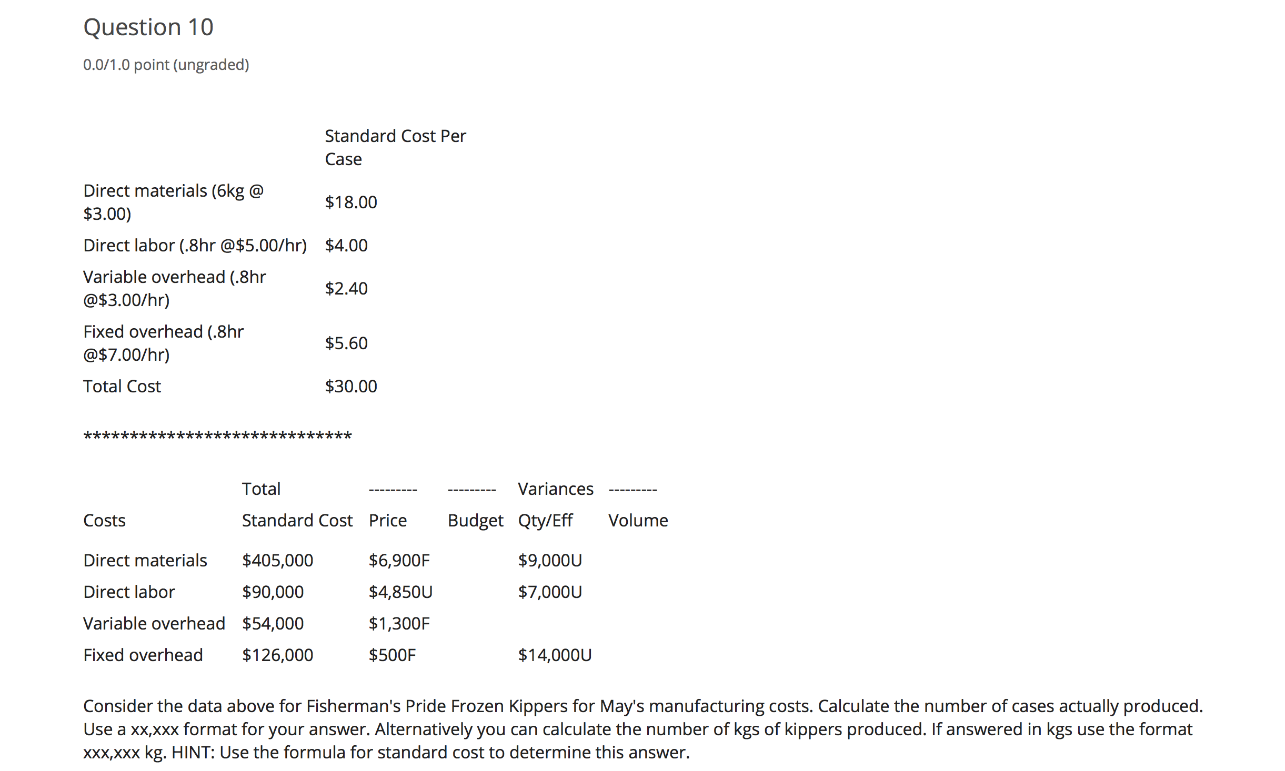
MGT8803 Business Fundamentals for Analytics
Video Conference #5 Managerial Accounting Sample Quiz Problem #10, #11, and #12
The manufacturing process at Fisherman's Pride uses input bought daily from local fishermen. The input (raw Kippers) are seasoned, prepared and frozen. During the process a small amount of material is wasted either through spoilage or rejection for poor quality.

Slide 12
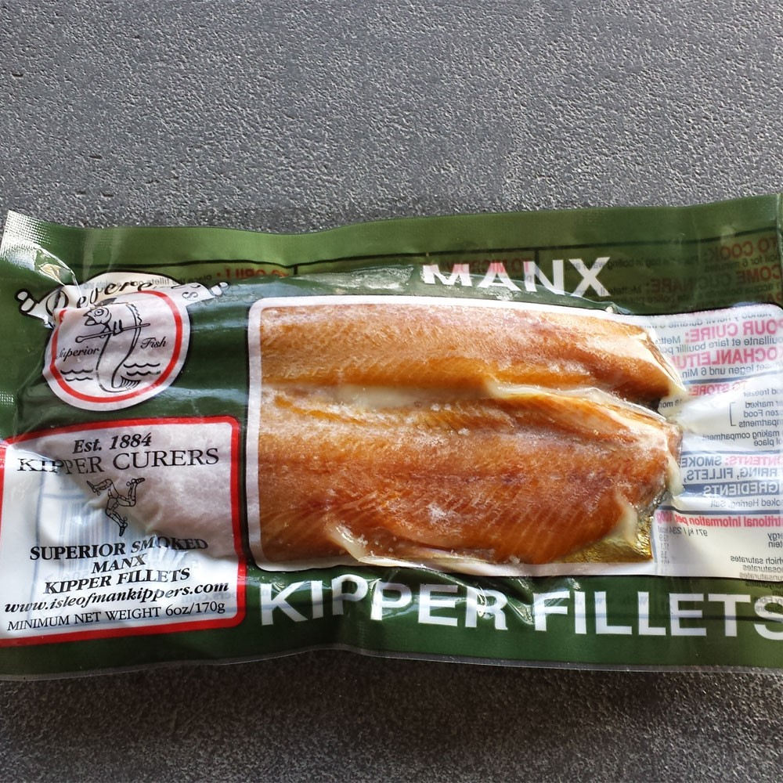
MGT8803 Business Fundamentals for Analytics Video Conference #5 Managerial Accounting Sample Quiz Problem #10, #11, and #12 Fisherman’s Pride Frozen Kippers
Standard Cost Per Case
Direct materials (6kg @ $3.00) $18.00
Direct labor (.8hr @$5.00/hr) $4.00
Variable overhead (.8hr @$3.00/hr) $2.40
Fixed overhead (.8hr @$7.00/hr) $5.60
Total Cost $30.00
*****************************
Total --------- Variances ---------
Costs Standard Cost Price Budget Qty/Eff Volume
Direct materials. $405,000 $6,900F $9,000U
Direct labor. $90,000 $4,850U $7,000U
Variable overhead. $54,000 $1,300F
Fixed overhead. $126,000 $500F $14,000U

Slide 13
MGT8803 Business Fundamentals for Analytics Managerial Accounting Sample Quiz Problem #10, #11, and #12
Standard Cost = $405,000; Standard Price = $3/kg; variances price $6,900F quantity $9,000U
(Remember that Standard Quantity is the actual amount of material that SHOULD
have been used to produce the actual output). In this problem Standard Quantity is determined by
The formula SC = SP * SQ; $405,000 = $3 * SQ
Standard Quantity = which equals 135,000 kgs. This is the answer to question 10. In terms of cases
22,500 cases was the actual number of cases produced (6kgs of processed kippers per case)
How much raw material (kgs of kippers) was actually used. To answer this question use the Materials Quantity Variance.*
Actual Quantity is determined by SP (AQ – SQ) = MQV
+$9000 = $3 (AQ – 135,000kg)
+$9000 = $3AQ - 405,000 AQ = 138,000
Actual Price is determine by 138,000 (AP – 3) = MPV
-$6900 = 138,000(AP - $3), AP = 2.95
Total Material Cost Variance = (AP*AQ) – (SP*SQ) = Total Material Cost Variance
($2.95 * 138,000) – ($3 * 135,000) = $2,100. U
*The term Material Usage Variance may be used in some situations rather than Materials Quantity Variance. The terms are interchangeable

Slide 14
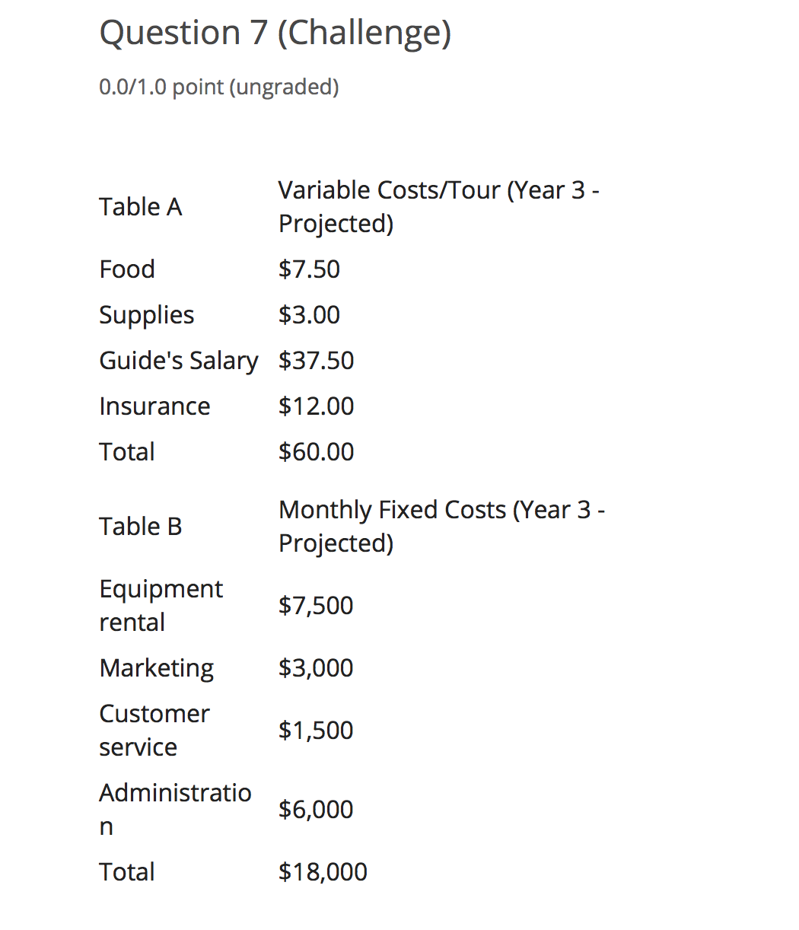
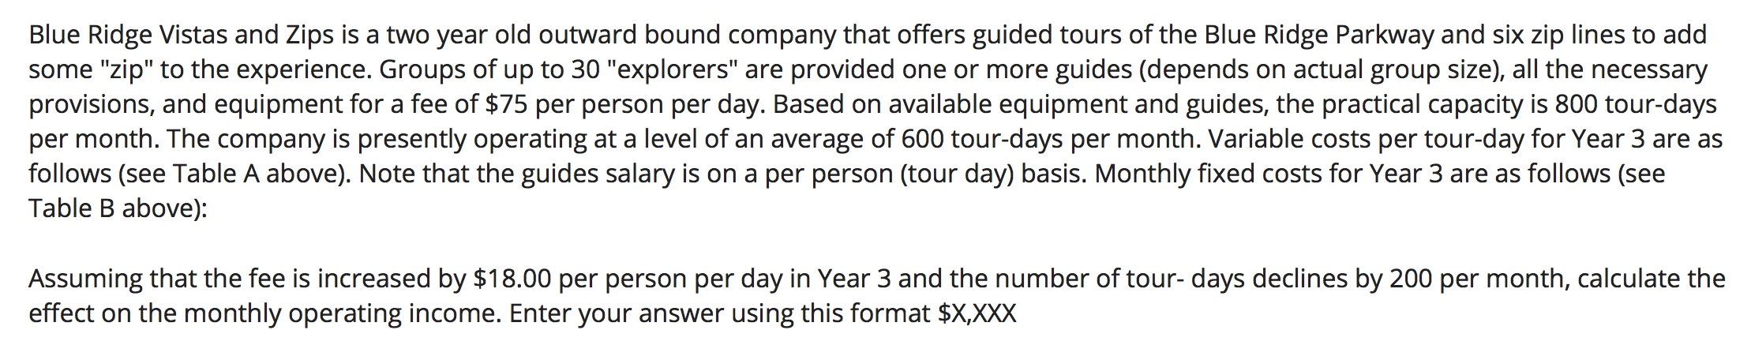
MGT8803 Business Fundamentals for Analytics
Video Conference #5 Managerial Accounting Sample Quiz Problem 7

Slide 15
Video Conference Call #5 Managerial Accounting Sample Quiz Problem #7 and #8 Blue Ridge Vista and Zips
Question 7: Effect on monthly income if price is increased $18/tour but demand drops
By 200 tours.
The fixed costs of $18,000 will the same under the original and the revised pricing scheme so its not relevant to the decision whereas the variable cost of $60/tour day is.
Original contributing margin (the difference between the price and the variable costs is
= $75 - $60 = $15/tour day. $15 * number of tours (600) = $9000. If the firm raises prices by $18/tour, the contributing margin will be $93 - $60 = $33/tour day. $33 * number of tours (600 -200) = $13,200. $13,200 - $9,000 = $4,200. So raising the tour day price is the best option.

Slide 16
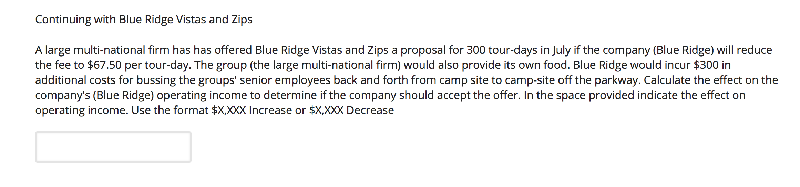
MGT8803 Business Fundamentals for Analytics
Video Conference Call #5 Managerial Accounting Sample Quiz Problem #7 and #8
Question 8: Should the firm take the national firm offer?
The fixed costs of $18,000 will the same under the original and the revised pricing scheme so its not relevant to the decision. The incremental fixed cost for the new offer ($300) is relevant. The reduction in variable costs ($7.50 for food) is also relevant. The contributing margin for the national firm offer is = $67.50 – ($60 - $7.50) = $15.00 * 300 (number of tour days) = $4,500. The incremental profit will be $4,500 – $300 (the bus) = $4,200. However to accept the deal there is an opportunity cost of 100 tours days at the full price of $75 (and associated variable costs of $60). The opportunity cost is 100 * $15 or $1,500. So the incremental profits of accepting the national firm offer is = $4,200 - $1,500 = $2,700. So the offer should be accepted.

